Slide 2
Three habits
Wonder why
Be real
Hope together
Listen to others’ stories and see the world through their eyes.
Encounter others with authenticity and confidence.
Find hope and opportunity in the places where we long to see changes.

Slide 4
What do we learn about navigating disagreement in this film?

Slide 5
Jesus and the woman at the well
John 4:3-42

Slide 6
Questions for discussion
Did Jesus and the woman avoid difficult topics or express their differences? Where do you see this?
What helped them have a good conversation even though they had different views?
How would applying the lessons we learn from Jesus and the Samaritan woman help us when we have disagreements?

Slide 7
Luke 6:31
“Do to others as you would have them do to you.”

Slide 8
Questions for discussion
How would applying this help us when we have disagreements?
Where do you see similar principles and values in other faiths, worldviews or cultures and community traditions?

Slide 9
Shrug, shout, shh

Slide 11
You and your friend disagree about what film to see at the cinema.

Slide 12
Your parent or guardian tells you that you should be doing your homework when you’re exhausted at the end of a long day.

Slide 13
Someone in your class says that male footballers should get paid more than female footballers.

Slide 14
Your friend tells you that your favourite singer/band is worse than their favourite.

Slide 15
You find out that your parent or guardian votes for a political party you don’t like.

Slide 16
Your friend says they don’t believe in climate change.

Slide 17
Agree or disagree?

Slide 18
Blind spots

Slide 19
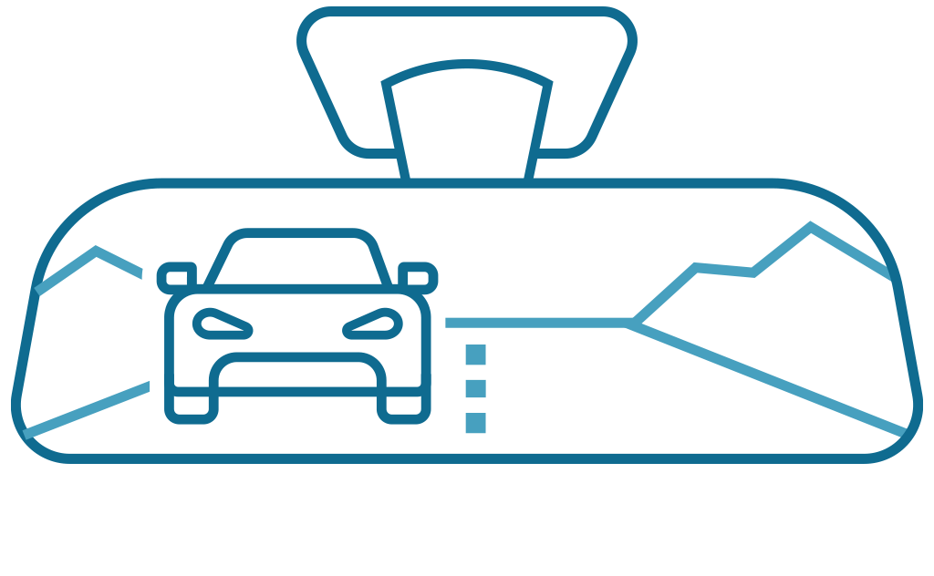

Slide 20
Cancel culture

Slide 21
“Cancelling people pushes them away and makes them more likely to find spaces where bad views are the norm... Cancel culture, as I see it, involves the shutting down of different perspectives” – Matt Haig
“Being called out has made me a better person. Not being cancelled has enabled me to be accountable, learn from my mistakes, and go on to share those lessons with others and do good with my privilege” – Jameela Jamil
“[Cancel culture creates a] culture of accountability which... needed to come into being.” – Lisa Nakamura

Slide 22
What are the things we can see?
What things might be happening that are harder to see?

Slide 24
What is something you want to remember from this session?

Slide 25
Prayer and reflection
Loving God, fill us with your Spirit now.
We think about what we have learnt about empathising with the person we disagree with.
Help us to be curious about others’ stories – listening as often as we speak.

Slide 26
We think about someone who we often disagree with and what we have learn about building good relationships even when we disagree.
Give us the courage to be present – showing up and sticking around.
We think about the things we have learned about navigating disagreement in this session.
Inspire us to reimagine what’s possible – finding hope, knowing that you can transform all things.
In Jesus’ name. Amen

